Slide 1
Data Modeling 101
What, How, and Why it’s more than PCDM
Notes:
Hi, I'm Mark Matienzo, and I'm one of the facilitators of the Data Modeling 101 workshop. Welcome - we hope you learn a lot today!

Slide 2
Your Fearless Facilitators
Julie Metadata Analyst at Indiana University, @jlhardes
Christina Works on Metadata at Cornell, @cm_harlow
Tom Ph.D. Student at University of Wash. iSchool; DCE, @no_reply
Mark Collaboration & Interoperability Architect, Stanford @anarchivist
Notes:
Let's do a quick introduction to the facilitators.

Slide 3
bit.ly/HC16DataModels
Link for Google Drive Folder with Slides, Notes, Examples, Resources, & Other Workshop Materials
Notes:
First, here's a handy link to a Google Drive folder containing slides, a notes document, examples, resources and other materials. Please take note of the "info document" in the folder - that has details on what we're doing today, and if you registered for the workshop by the registration deadline, you should have received a link to that document already.

Slide 4
Communication Channels
Alert a facilitator if you need help or have questions
Project Hydra Slack: #hc2016-datamodeling channel
https://project-hydra.slack.com/
Sign up for an invitation here: http://slack.projecthydra.org/
Notes:
Just to quickly touch on communications, you should feel free to one of the facilitators know if you need help or have questions. We also have a Slack channel set up in the Project Hydra Slack as a way to share information or to ask non-time sensitive questions. If you need help getting access, please let one of the facilitators know.

Slide 5
Schedule
9-9:15 | Introduction
9:15-10:15 | Intro to Data Models: How Models Work w/Systems
10:15-10:30 | 15 minute break
10:30-10:45 | Intro to Data Models: Expressing Models
10:45-11 | Breakout groups: Intro & Setup
11-11:45 | Breakout groups: Data Models Breakouts
11:45-Noon | 15 minute break
Noon-12:15 | Breakout groups: Recaps
12:15-12:30 | Going Forward with Data Modeling & Hydra

Slide 6
Our Expectations of You
Follow the Project Hydra Code of Conduct
Follow the Recurse Center Social Rules (a.k.a. "Hacker School Rules")
Be ready to learn about data modeling!
Notes:
So, as we start, we have specific expectations of you. First, we expect and require everyone here to follow the Project Hydra Code of Conduct. This is designed to keep you and everyone else in a safe and welcoming environment, free from harassment. I'll talk more about that in just a moment. Secondly,, we expect you to follow a set of social rules developed by Recurse Center, intended to foster a welcoming environment for learning and experimentation. I'll also go over those rules shortly. And lastly, be ready to learn about data modeling!

Slide 7
Project Hydra Code of Conduct
https://wiki.duraspace.org/x/GJsOB
Notes:
The Hydra community is dedicated to providing a welcoming and positive experience for all its members, whether they are at a formal gathering, in a social setting, or taking part in activities online. The Hydra community welcomes participation from people all over the world and these Hydranauts bring with them a wide variety of professional, personal and social backgrounds; whatever these may be, we treat colleagues with dignity and respect.
Hydranauts communicate primarily in English, though for many of them this is not their native language. We therefore strive to express ourselves simply and clearly remembering that unnecessary use of jargon and slang will be a barrier to understanding for many of our colleagues. We are sensitive to the fact that the international nature of the community means that we span many different social norms around language and behaviour and we strive to conduct ourselves, online and in person, in ways that are unlikely to cause offence.
Hydra conversations are often information-rich and intended to generate discussion and debate. We discuss ideas from a standpoint of mutual respect and reasoned argument.
Hydranauts work together to promote a respectful and safe community. In the event that someone’s conduct is causing offence or distress, Hydra has a detailed Anti-Harassment Policy and Protocol which can be applied to address the problem. The first step in dealing with any serious misconduct is to contact a local meeting organizer, the Hydra community helpers, a community member you trust, or the Hydra Steering Group immediately.
For the full code of conduct and information on the anti-harassment policy, please use the link listed here, which is also available in the notes document. Please let any of the facilitators, Hydra Helpers, or members of the Hydra Connect Host Committee know if you feel unsafe or need to report an incident during the workshop. Could I have the co-facilitators, Tom, Julie, and Christina identify yourselves by raising your hands or signaling in some other way? (pause) And if you're on the Hydra Connect 2016 Host Committee or a Hydra Helper, could you self identify now, by raising your hands or signaling in some other way?

Slide 8
Recurse Center Social Rules
(a.k.a. Hacker School Rules)
https://www.recurse.com/manual#sub-sec-social-rules
No feigning surprise
No well-actually's
No back-seat driving
No subtle -isms
More info: https://www.recurse.com/blog/38-subtle-isms-at-hacker-school
Notes:
In addition to the code of conduct, we also ask that all of you follow a set of rules designed by the the Recurse Center, previously the Hacker School, which organizes a free, self-directed educational retreat for folks who want to get better at programming regardless of their experience. In their own words, 'the goal isn't to burden everyone with a bunch of annoying rules, or to give us a stick to bludgeon people with for "being bad." Rather, these rules are designed to help all of us build a pleasant, productive, and fearless community.'
As such, these four rules are a lightweight set of explicit social norms to curtail specific kinds of behavior found to be destructive to a supportive, productive, and fun learning environment. The four rules are listed here; you can read about them more on the provided link to www.recurse.com/manual - but I'll touch on all of them briefly.
First, "No feigning surprise." You shouldn't act surprised when someone says they don't know something." There is no benefit to feigning surprise, and regardless of intent, it makes someone feel bad, or worse, about admitting that they don't know something.
Secondly, "No well-actually's." This is when someone says something almost, but not entirely correct, and another person responds with "well, actually," and gives a correction. That's not to say we don't care about truth or precision, but there are better ways to communicate this.
Next, "No back-seat driving." If you overhear other people working through a problem, don't just intermittently toss advice in without engaging. We encourage you to help others to learn within this workshop, but when you do so, make sure you're fully engaged
Finally, "No subtle -isms". This last rule bans racism, sexism, homophobia, transphobia, and other kinds of bias. Subtle -isms are small things that make others feel uncomfortable, and might be familiar as they're under the term "microagressions." It's not targeting slurs, harassment or threats - activities not tolerated under the code of conduct, but the little things - saying things like "it's so easy that my grandmother could do it." If you see or hear this happen, you can point it out to the person either publicly or or let one of the facilitators know.

Slide 9
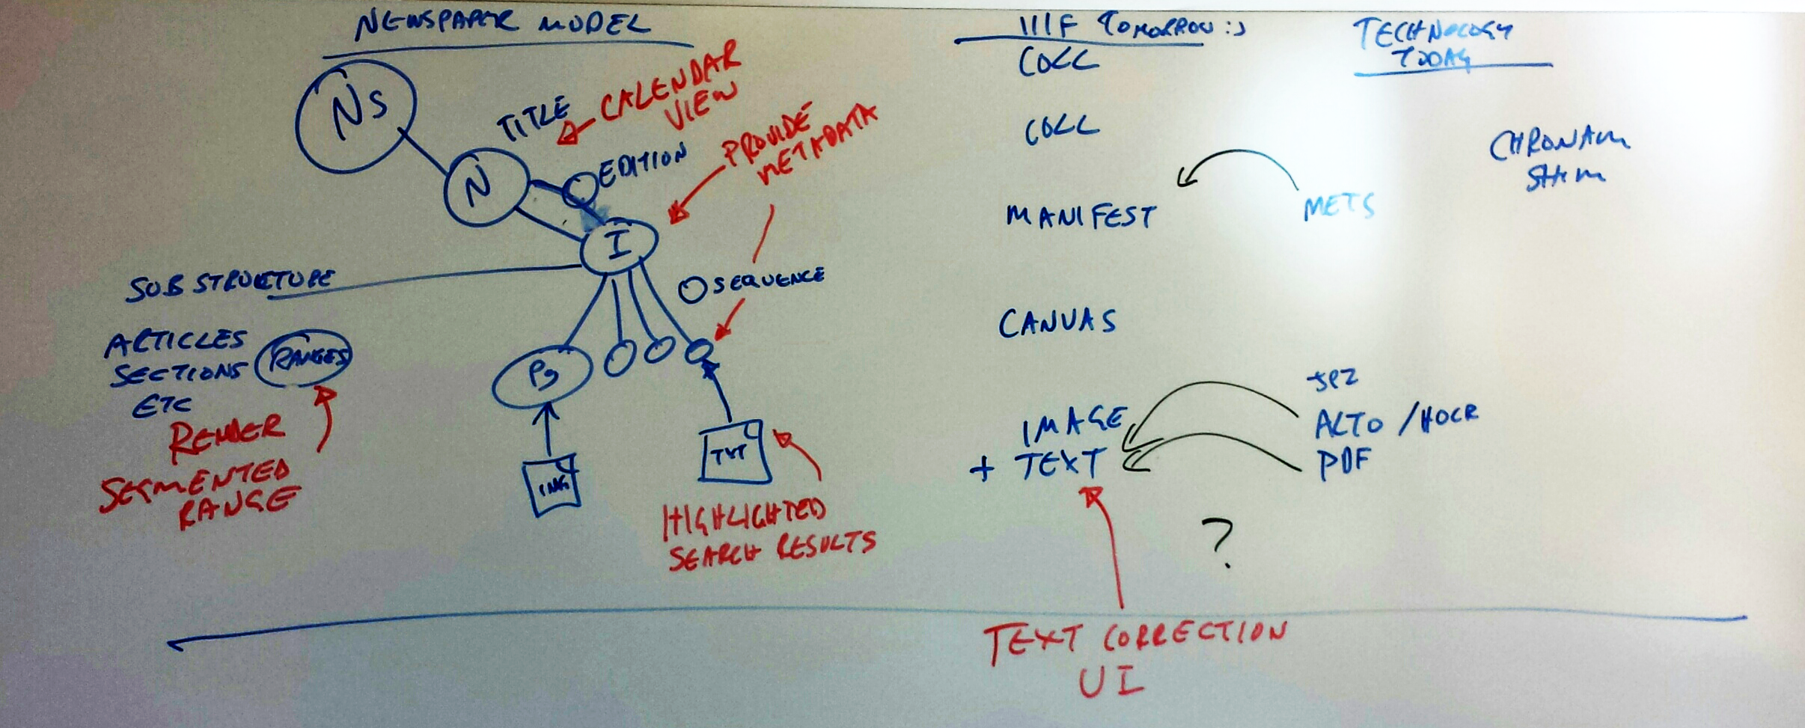
Are you ready to data model?
Notes:
The last is be ready to learn about data modeling. While that might be obvious if you're here for this workshop, it also just allows us to check in and make sure that everyone here is in the right place. So, if you're *not* here for the Data Modeling 101 workshop… feel free to stay or leave, but we expect you to be engaged, especially during the breakout session.

Slide 10
Reminder
This is an informal workshop – ask questions!
Notes:
As facilitators, we also want to remind you that this is an informal workshop and that you are encouraged to ask questions at any point. Please raise your hand, reach out to one of us in the channel we set up for this workshop, or signal in some other way. I'll take a brief pause here just to see if there are any questions as we move forward. If you have any questions that are not pressing, feel free to share them in the Slack channel

Slide 11
This workshop is an attempt to
Help build data modeling capacity in the Hydra (and broader) communities
Help build best practices for data models
Notes:
So, let's move forward. The high-level motivations for this workshop are twofold: first, to help build data modeling capacity in the Hydra community and beyond, and to help build practices in the development of data models. It's been well acknowledged that the data modeling is an important skill and area of work to the Hydra community, but as yet we haven't seen a whole lot of steps forward in the community. This need is precisely why we proposed the workshop - as a way to start building a corps of folks interested in data modeling, and to help grow that community into one that can facilitate the development of these best practices within the Hydra community.

Slide 12
Our goals for this workshop
Share motivations for data modeling as part of the application development process
Equip you with knowledge needed to instigate modeling work at your institutions and participate in broader community discussions
Demonstrate modeling practices and pitfalls
Give context for data modeling, standards, and interoperability work in Hydra and related communities
Notes:
Let's briefly go over the goals for the workshop that we as the facilitators established. First, we wanted to you to understand the motivations for data modeling as part of the application development process. All of you, regardless if you're a programmer, a metadata librarian, a project manager, what have you, should have an understanding of why data modeling is important, and how it fits into software design and implementation. Understanding this will help you participate in that process. Building on that, we also intend for this workshop to allow you start modeling discussions at your own institutions and participate in broader discussions within the community, such as the development of PCDM 2.0.
In addition, we expect that this workshop should allow you to see common modeling practices and patterns that you can rely on to assist with your data modeling work, and pitfalls that you should avoid, either generally speaking or in the context of specific models. Finally, this workshop should provide context for data modeling, standards and interoperability work within the Hydra community and beyond. For example, this includes the desired interoperability of structural models based on PCDM; how models and data modeling firts in with other metadata standards; and how models are used as application artifacts.

Slide 13
However, this workshop is not ...
A linked data or RDF workshop
A metadata standards workshop
A PCDM workshop
... but options exist for learning more about these topics!
Notes:
Just to be clear, there are several things that this workshop is not intended to cover. First, this isn't a linked data or RDF workshop specifically. We'll be focusing on some specific models that are defined using RDF, however, so we're happy to answer any RDF-specific questions as they come up. Secondly, this is not a metadata standards workshop, although we hope to clarify the interactions between metadata standards, data modeling, and application time. Finally, this isn't a PCDM workshop...although we'll be using PCDM as an exemplar model in some of our discussions and breakouts later.

Slide 14
Now: your goals for this workshop?
Why are you attending this workshop?
What are your goals - immediate or long-term?
What's your level of comfort and experience with data modeling?
We want to capture your goals, return to them throughout the workshop & going forward - feel free to add to responses to the shared notes.
Notes:
We want to hear your goals for the workshop. Obviously we have a big group here, so we can't go through everyone. Please add your goals and answers to these questions in the shared notes document if you're comfortable sharing. Just so we can have folks hear them as well, we'll ask a few of you for your goals now, if you'd like to raise your hand or signal in another way.
Now that we've gotten some of your goals from you, I'll pass it off to Tom to take the next section.

Slide 15
Introduction to Data Modeling
What is it & why do it?
Notes:
Transition from Tom’s slides
Points covered in list form
But what does this look like in our work
How do we express data models?
I.e. what’s the context?

Slide 16
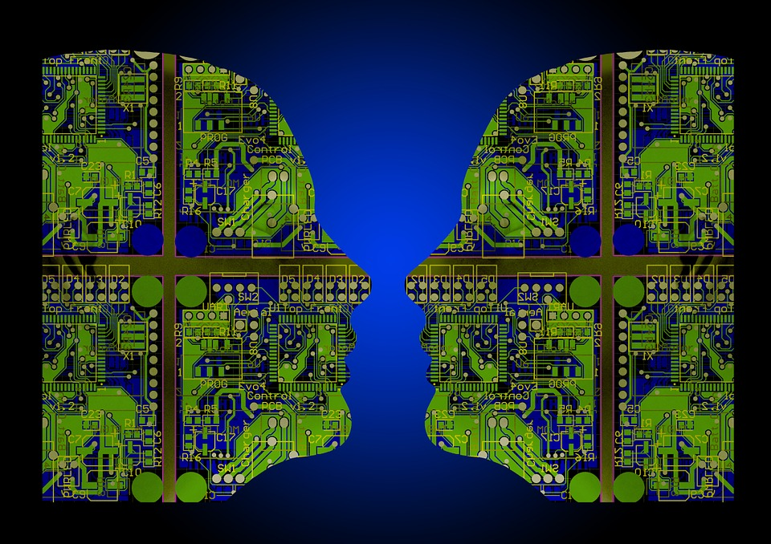
What Do Systems Know?
Notes:
Start with this question because it’s really at the core of what data modeling is and why we do it...
What does it mean for a system to know something? What kinds of systems know things? What kinds of things do they know?
[Do something funny with AI or machine learning to make the point about “knowing” w.r.t. Information Systems vs. learning or intelligence, where the model (the specifics of what is known) is inscrutable to the designer. ???]
For the purposes of data modeling, we’re interested in systems that are designed, and that do some combination of storing, updating, and disseminating information. Loosely, we can call these Information Systems. A close synonym is Enterprise System.
That’s a pretty vague definition, let’s talk about an example.

Slide 17
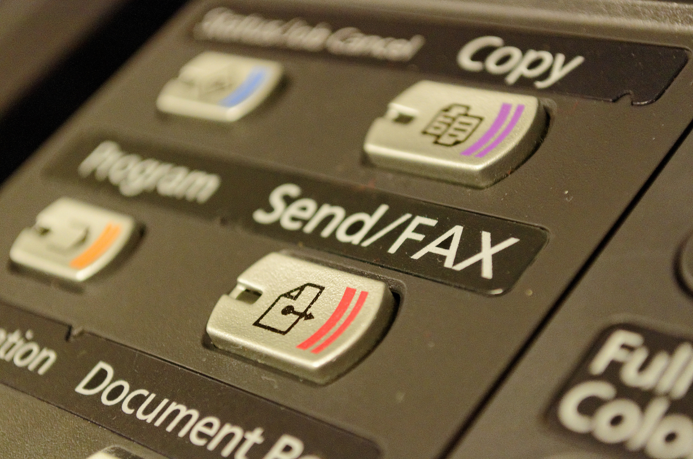
What Does a Fax Machine Know?
CC-BY 2.0 https://www.flickr.com/photos/itupictures/
Notes:
Fax Machine (credit to Olivé): The system doesn’t “know” about the document; it can’t tell you anything about the document.
Ask participants:
What does this system do? (softball)
What kinds of objects does it know about?
Lead from documents to other functions. Is there a sense in which it knows about the document?
Recipient, fax numbers, etc…
If we haven’t gotten to this already: point out that the fax/copy machine itself isn’t an Information System. Why not?
What (kinds of) objects could you tell exist if you could inspect and understand the system’s design?
(Maybe not documents; they move through the system so ephemerally that the system only cares about a bytestream and a signal)

Slide 18
Questions for Modelers
What things/kinds of thing does the system work with?
What functions/actions does it perform?
What does it remember?
What does it need to be able to tell its users?
How do the answers change as the system does its work?
Notes:
[modeling questions, system requirements…]

Slide 19
Questions for Modelers
What is the domain?
Notes:
Not just having information, but:
Being designed to have information.

Slide 20
Where is the Knowledge?
Database & System State
Long term storage, in-memory representations.
Code
OO Models, other code that handles data.
Serializations
Output for interchange, etc…
Design Documents
Diagrams, Descriptions, UML, etc…
Notes:
What the system “knows” (machine learning & AI notwithstanding), can be spread throughout many parts of the system and depend on its state in complex ways. Predictably, determining what a system knows from the system itself is a challenge.

Slide 21
Where is the Knowledge?
‘Every information system embodies a conceptual schema. Without a conceptual schema, a system could not perform any useful function… The only available options are to explicitly define the schema or to have it in the minds of the designers.’
- Conceptual Modeling of Information Systems. p. 21
Notes:
The first benefit of including modeling as a part of your process is that it gives you the opportunity to extract the model--the details of the knowledge of the system--from the architects, developers, and other designers of the system, make it explicit and a part of the requirements and design process.

Slide 22
Defining “Data Model”
Notes:
Like a lot of terminology in this space, “data model” is overloaded. It’s useful to clarify what we mean, and where our sense of the term fits in.

Slide 23
Abstract Syntax
Data Type
Captures structure outside the context of a representation.
E.g. RDF “Data Model”:
‘This document defines an abstract syntax (a data model) which serves to link all RDF-based languages and specifications. The abstract syntax has two key data structures: RDF graphs are sets of subject-predicate-object triples, where the elements may be IRIs, blank nodes, or datatyped literals.’
- RDF Concepts & Abstract Syntax (abstract)
Notes:
Abstract Syntax

Slide 24
Physical Model
Data Structure
A representation of data in concrete form.
A serialized document;
A database schema;
A data structure (array, hashmap, B-tree, etc…).
Notes:
Abstract Syntax

Slide 25
Conceptual Model
Logical Model
Captures the concepts and relationships of the data. Higher-level than an abstract syntax; instead: An abstract schema.
The Three-Schema Approach:
External ↤ Conceptual ↦ Internal
Notes:
“Conceptual Schema”...
What is the model that underlies the interactions between users and the system (or between systems). What is the “interesting” level of abstraction for the system, what is the domain?
Three schema approach: Multiple external schemas (serialization formats, views, etc…). Multiple internal schemas (in-memory data structures, on disk representations, database schemas, etc…). One conceptual model to

Slide 26
RDFS, SKOS, PCDM?
Low-Level Model / Upper Ontology
A model that can be used to describe other, higher level models. An Ontology that presents a view of the world common to all Ontologies.
‘A metaschema is a schema that represents general knowledge about a domain that consists of a schema.’
- Conceptual Modeling of Information Systems. p. 400
Notes:
Occupy space between the Abstract Syntax and the Conceptual Model.
An Ontology that presents a view of the world common to all Ontologies within a scope of interest. Consider PCDM.
Let’s (not) talk about CIDOC CRM. [need more about this, some more slides, examples]

Slide 27
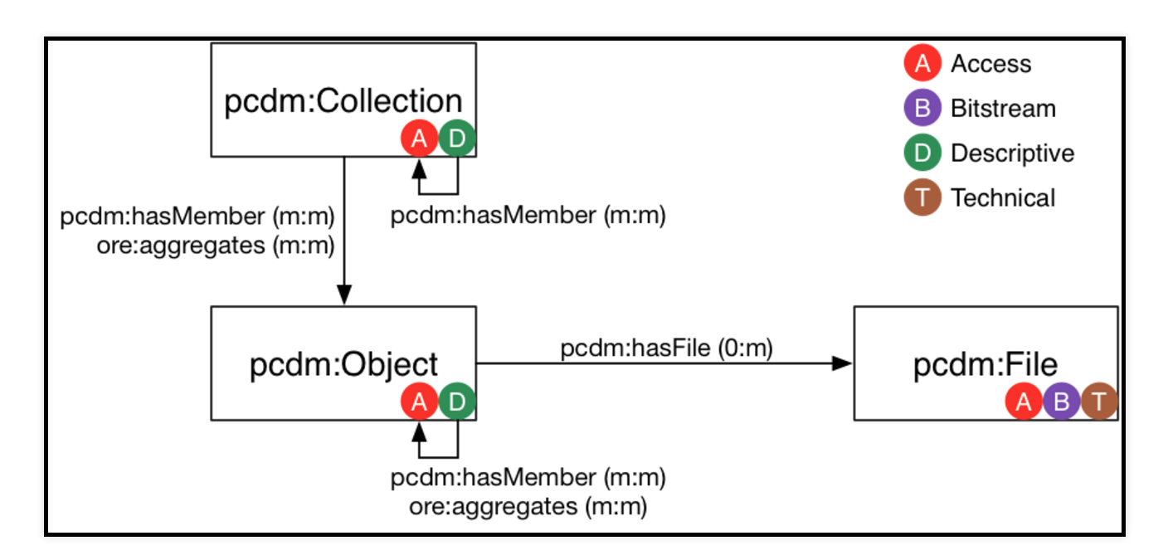
github.com/duraspace/pcdm/wiki
Notes:
PCDM as metamodel.

Slide 28
Motivations for Modeling

Slide 29
Model as an Application Artifact
Modeling for Design Feedback
The model acts as a specification of the Information System.
Model documents serve as documentation for the design team, developers, and users.
Provides common language and point of discussion for programmers, designers & domain experts.
Early opportunity to address ethical issues:
How does what we model in our systems create affordances and restrictions for our users?
Falsehoods Programmers Believe

Slide 30
Dissemination, Interchange, Interoperability
“The Informative Function” (Olivé)
Display to user as map to a View Schema.
Interchange
Map to External Schema for publication or API functions.
Interoperability
With systems that share a model or metamodel;
Transformations/crosswalks to systems that operate in a different domain or use a different model.

Slide 31
Consistency, Validation, Workflow
Database Constraints
Cardinality
Value Constraints (Consistency in database theory)
Validation Throughout a Lifecycle
Pre/Post-condition
Defined Workflows
Events, Actions, State Transitions
Notes:
Constraints and validation requirements can be expressed within a model, or in terms of the model.

Slide 32
One Approach:
Semantic Modeling
Notes:
Like a lot of terminology in this space, “data model” is overloaded. It’s useful to clarify what we mean.

Slide 33
Objects & Relations
One kind of “Object” (Entity, Resource)
Objects are distinct from their names & from their records.
Binary Relations between objects
Interpreted as sentences: (person isAuthorOf book)
And as facts.
Group objects into Classes (or Entity Types)
(person isA Person)
Notes:
One Kind of Thing: (an Object or a Concept or an Entity or a Resource)
One Kind of Expression: a (binary) Relation
Binary Relations as Facts

Slide 34
Objects & Relations
Object 1
Collection 1
Is Part Of

Slide 35
Types of Relations
Instances of a Relation Class
Domain & Range
Not a constraint!
Common relation types:
Partitive (chapter isPartOf book), (book hasPart chapter)
Membership (book isMemberOf collection)
Materialization (book isPortrayalOf work)
Role
Type (person isA author)
Surrogate (author isRoleOf person, book hasAuthor author)
Notes:
rdf:Property
Talk about set notation from Conceptual Modeling

Slide 36
Subsumption
Class
If A is a subclass of B and x is a member of A, x is a member of B.
cf. Liskov Substitution Principle in OO
E.g. Mammal subClassOf Animal
Property
If P is a subproperty of P′ and x P y, then x P′ y.
E.g. hasMother subPropertyOf hasParent

Slide 37
RDFS
Construct | Syntactic form | Description
Class (a class) | C rdf:type rdfs:Class | C (a resource) is an RDF class
Property (a class) | P rdf:type rdf:Property | P (a resource) is an RDF property
type (a property) | I rdf:type C | I (a resource) is an instance of C (a class)
subClassOf (a property) | C1 rdfs:subClassOf C2 | C1 (a class) is a subclass of C2 (a class)
subPropertyOf (a property) | P1 rdfs:subPropertyOf P2 | P1 (a property) is a sub-property of P2 (a property)
domain (a property) | P rdfs:domain C | domain of P (a property) is C (a class)
range (a property) | P rdfs:range C | range of P (a property) is C (a class)

Slide 38
Our Semantic Modeling Bias: Other Approaches
Hierarchical
Network (see:Programmer as Navigator, Bachmann)
Relational
Object Oriented
More abstractly:
Entity-Relationship
Object-Role
Definitional Theory

Slide 39
Our Semantic Modeling Bias: What Gives?
Avoid “Database Orientation”
or language specific “data structure orientation”.
or “document model orientation”.
Focus on Interoperability
Semantic Modeling = data is self-describing in a known semantics. (wat?!)
Simplicity
model reduces to a single kind of object and binary relations.
“Simple” not to be confused with “easy”.
Notes:
http://hpdrc.cs.fiu.edu/library/books/datades-book/
Avoiding a “Database Orientation”: Databases come in many types, all with trade-offs and design constraints. Database design influences (and is influenced by) the models that databases support (e.g. E-R modeling in RDBMSs). Generally speaking, our opinion is that modeling decisions that will affect the entire system shouldn’t strongly consider these implementation details.
Similar considerations hold for language support for data structures, and for document models (XML, JSON, etc…)
This argument applies especially at the design phase or where interoperability is a concern.
Interoperability: Characterize the semantic modeling as: the data is self-describing in the context of a given abstract syntax & semantics. (How real is this benefit for Hydra or for LAM use cases, as opposed to e.g. bioinformatics?)
Simplicity: the semantic modeling approach is “simple” in the sense that it has few components. At it’s core, the model has only one kind of thing, and only one kind of expression. A lot of the theory is shared between this and other approaches, especially those developed since the late ‘70’s; the simple approach has the benefit of being general purpose, which is a good fit for our stated goals for the workshop and for the problem of Conceptual Modeling, as it’s positioned by the three schema approach.

Slide 40
15 Minute Break
Reconvene at 10:30 AM

Slide 41
Modeling in (a) Context
What does Data Modeling as described look like?
Notes:
Transition from Tom’s slides
Points covered in list form
But what does this look like in our work
How do we express data models?
I.e. what’s the context?

Slide 42
‘Unfortunately, these disciplines have not yet reached agreement regarding the terminology, concepts, and mechanisms that we use to distinguish between the objects and relationships in a domain. Consequently, we do not have a solid theoretical basis on which to base our study, and, as is often the case when discussion information systems, we must adopt a humble and eclectic attitude.’
- Conceptual Modeling of Information Systems. p. 10
Notes:
In our preparatory reading, there is a line that sticks out to me.
Here, Olivé is discussing that the field Conceptual modeling in Information Systems has no set, theoretical basis, it adopts concepts, ideas and logic from a number of fields.

Slide 43
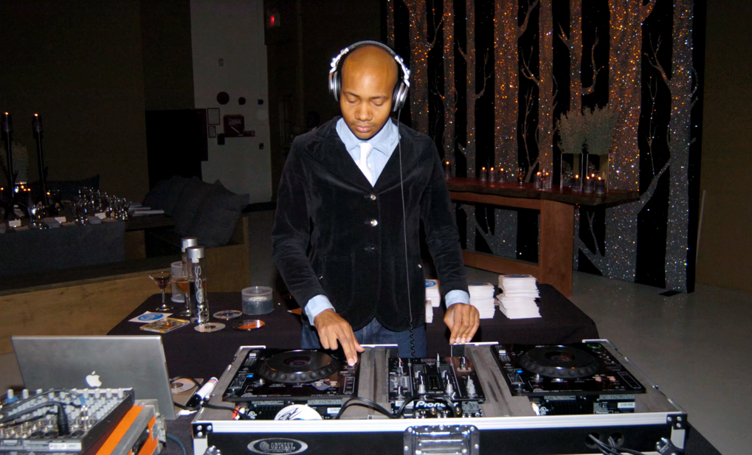
Communication & Data Modeling
“humble & eclectic attitude”
Photo from http://observer.com/2013/03/dj-spooky-spins-off-from-90s-turntable-phenom-to-the-mets-first-artist-in-residence/
Notes:
I think we can apply this also to the context and work we do. Data Modeling in our repositories work involves many sub-domains, departments, units, and needs, so we should adopt a humble and eclectic attitude as well. Data modeling sits at the intersection of a number of workflows and work areas, and it is best served when it can be a way to communicate needs, knowledge, and understanding across them.

Slide 44
Communication of Needs: An Example
Our repository contains digital collections. Digital collections contain objects that are both born-digital and digital surrogates of analog objects. Objects can be a book, journal, image, artwork, or other. Objects can contain multiple parts. Each object or part can have a digital representation. It may have multiple files for different types of representation.
Digital collections should have curators, titles, identifiers. Objects could have titles, subjects, identifiers, creators, languages, and relationships to other bibliographic resources.
Some digital collections and some objects can be viewed by only a subset of users. All objects can be edited only by a editors.
Notes:
So let’s start with a simple example for clarification of where a domain, data model development process starts.
Read through text

Slide 45
When Starting Towards Modeling...
What concepts exist?
Entities?
Relationships?
Types?
Operations?
What information structure do you want to preserve?
Any existing models or patterns you could use?
Notes:
With our description of starting needs, ideas, we can then ask ourselves a set of question similar to what Tom mentioned to us as serving the basis for ‘questions for modelers’. Namely - the questions on the slide.

Slide 46
Communication of Needs: An Example
Our repository contains digital collections. Digital collections contain objects that are both born-digital and digital surrogates of analog objects. Objects can be a book, journal, image, artwork, or other. Objects can contain multiple parts. Each object or part can have a digital representation. It may have multiple files for different types of representation.
Digital collections should have curators, titles, identifiers. Objects could have titles, subjects, identifiers, creators, languages, and relationships to other bibliographic resources.
Some digital collections and some objects can be viewed by only a subset of users. All objects can be edited only by a editors.
Notes:
So with this example, which should be somewhat common, what can we pull out? How do we answer the questions on slide?

Slide 47
Communication of Needs: An Example
Our repository contains digital collections. Digital collections contain objects that are both born-digital and digital surrogates of analog objects. Objects can be a book, journal, image, artwork, or other. Objects can contain multiple parts. Each object or part can have a digital representation. It may have multiple files for different types of representation.
Digital collections should have curators, titles, identifiers. Objects could have titles, subjects, identifiers, creators, languages, and relationships to other bibliographic resources.
Some digital collections and some objects can be viewed by only a subset of users. All objects can be edited only by a editors.
Notes:
One approach is to look for concepts - entities and relationships. We can even apply the pattern sequences discussed in Olivé to find concept candidates in our domain. Thinking loose and fast with pattern sequences, we see these concepts arise:
(go through groups above in black)

Slide 48
Communication of Needs: An Example
Domain: Digital Repository
Classes: digital collections, (digital) objects, analog/physical objects, parts, representation, formats, user, editor, …
Attributes: titles, subjects, identifiers, creators, languages, …
Relationships:
Collection contains Object ; Object contains Part
Object or Part has Representation
Object is a digital Surrogate of Analog/Physical
Operations:
Subset of Users can view Objects
Editors (Type of Users) can edit Objects
Types/Enumerations: (format) book, journal, image, artwork, …
Notes:
Now we’ve pulled out those concepts and more informally organized them, we can start to see concept types and relationships surfaced. You can go as deep or not with this approach. Above are some concepts using mostly the terminology we found in our readings - see, for example, types or enumerations.

Slide 49
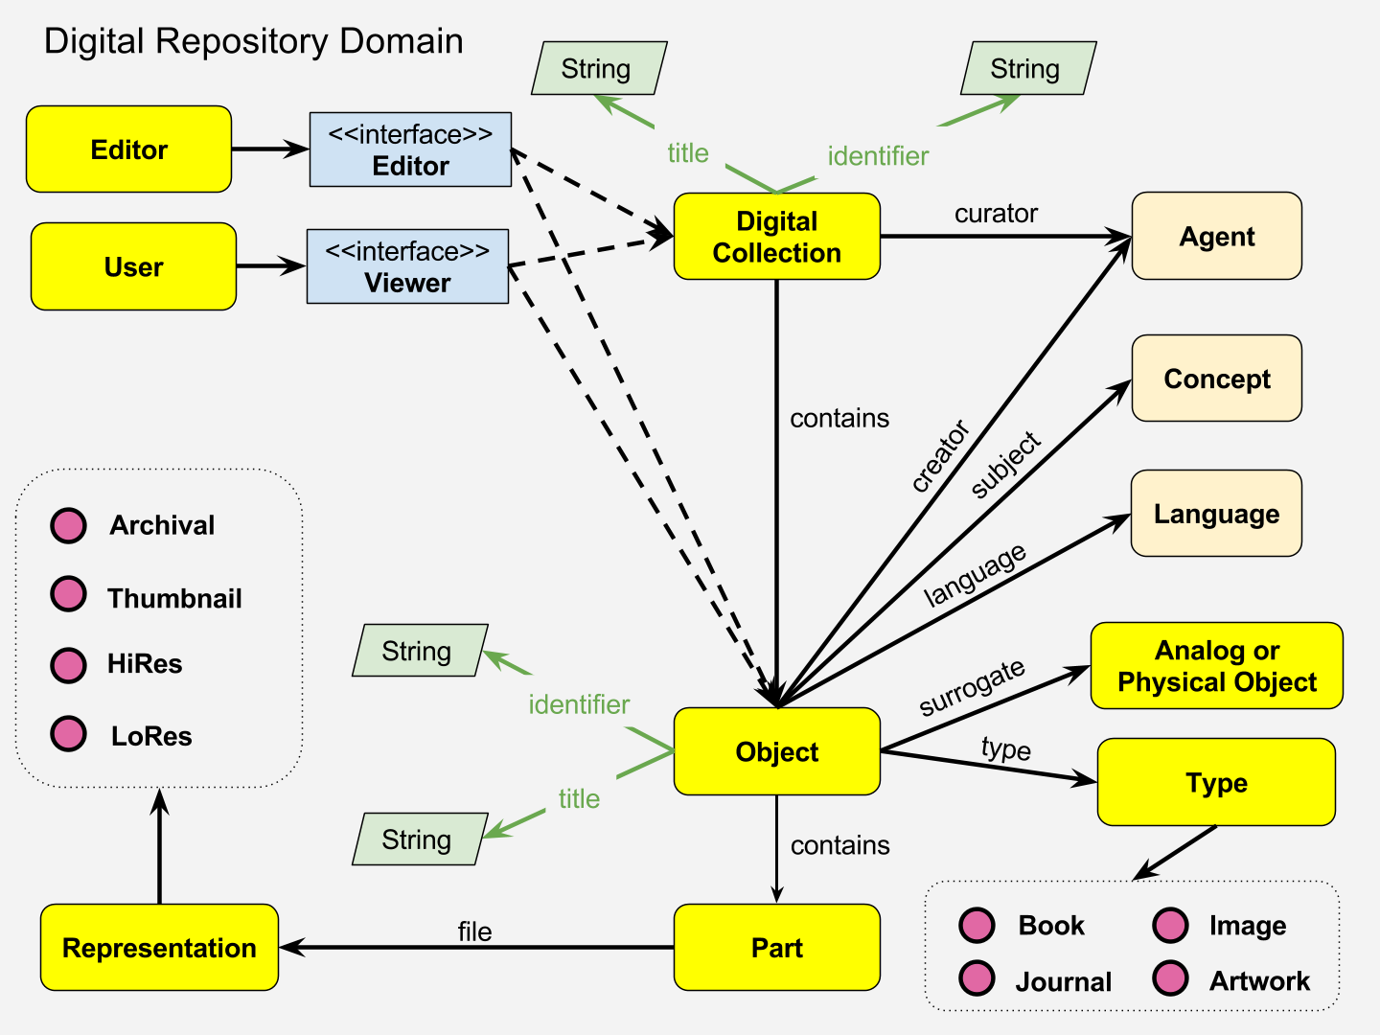
One Possible View…
Notes:
Now you could start to capture this model a few different ways - I’ll touch on the some expression languages in a bit - but here we can see one way you’d start to represent the information surfaced previously.
/Go through quickly concepts - entities, relationships, further information captured, stuff not yet captured.
Problems? See how we’re indicating concepts that we’d hope to pull from shared domains concepts (Agent, Concept, Language).
Note that relationships versus concepts can get rather difficult to pin down. This leads to reification and related discussions later.

Slide 50
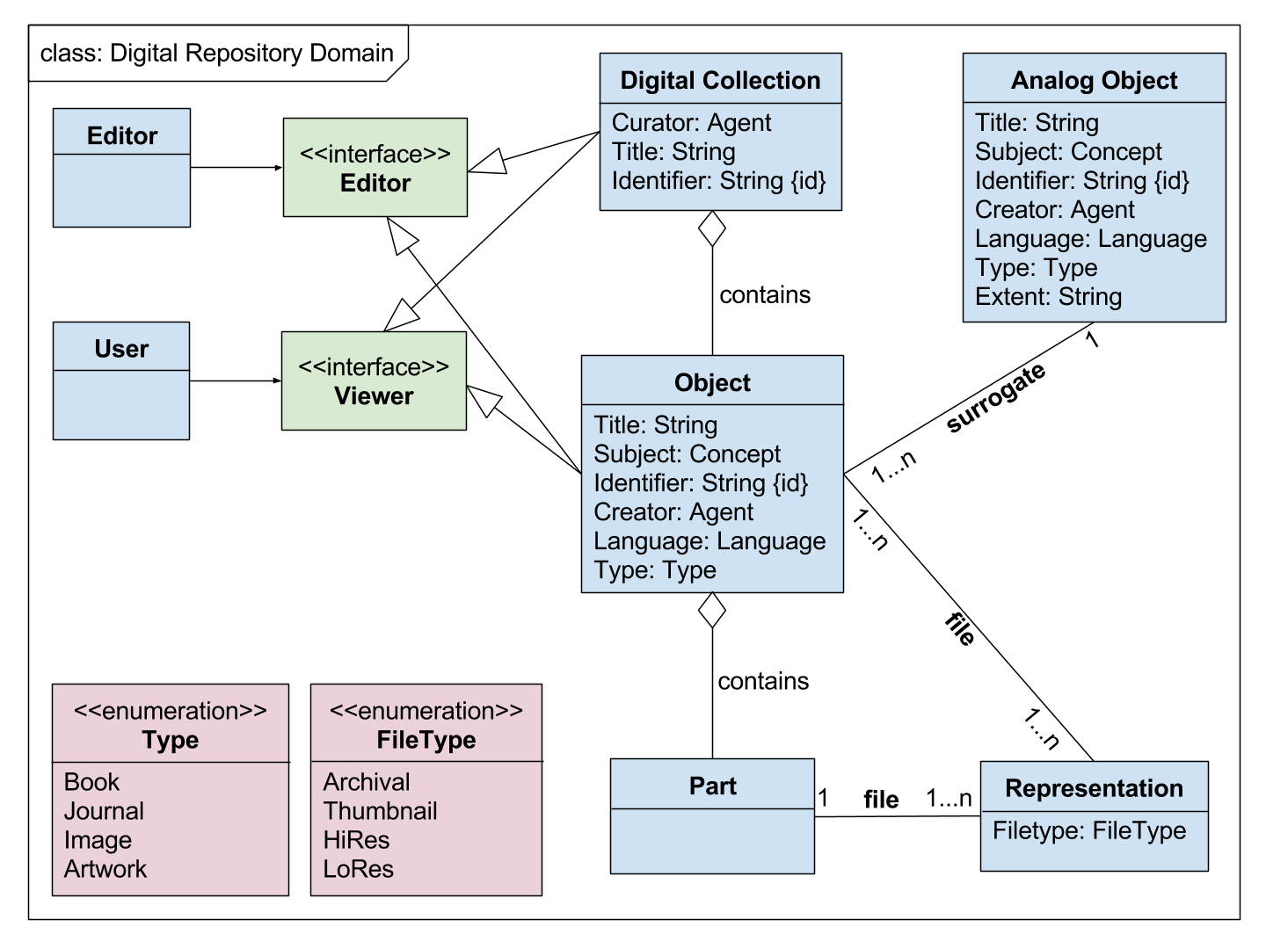
Another Possible View…
Notes:
And here’s possibly another way to represent the information surfaced. We see similar information captured, in just a different expression language. Here we see that information that should pertain to related but other domains, we can reference but not remodel.
/Go through quickly concepts not previously covered as it varies from previous in design.
You’ll see that grabbing information in this way begins to surface questions like - can we share common datapoints between classes (Analog Object and [digital] Object) through inheritance? Data propogation? Other?
Now what does this gain us? Well, we can capture and confirm understandings as well as requirements. We have a data model that is outside of application specifics. And find possible areas for expansion.
We can see where some areas might be able to leverage existing models - such as the access permissions we know we need at a high level here and our awareness of WebACL Model.

Slide 51
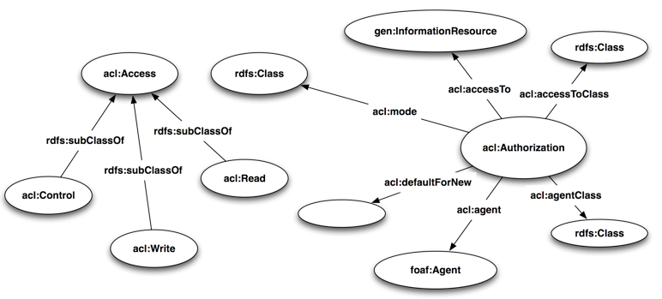
Data Models & Application Independence
W3C WebAccessControl Model
Our Model
WebAC Implementations
Notes:
Speaking of the WebACL model, lets use that surfaced possible reuse opportunity to underline the value of application independence here.
Keeping this application independent - or creating a data model that then gets translated or has a subset represented in your logical/physical/external/internal models - means we can capture an understanding of needs that is flexible as applications migrate or evolve.
Here, we have our conceptual model to the right. We see a portion of that could leverage the existing community WebACL or W3C Web Access Control Language model, in the top left corner. And by leveraging that external model, it could support a variety of applications that are WebAC compatiable for achieving the functionality for the concepts we’ve defined. But we aren’t reliant on a particular application.

Slide 52
Preservation of Information via Data Models
If, or rather, as applications evolve/migrate, one can still decode the information context from the Model
Break reliance of understanding information on 1 person, process, database structure, or application
Capture Information Context for future re-use vis-a-vis the Conceptual Model
Notes:
Application independence also means we have captured an understanding of the information therein outside of a particular system context, enabling preservation of information across time. Think of how often you have to reconstruct the data model (and related functional requirements or agreements) from a database table that has been built very specifically for an application, not a data model. It’s problematic. It doesn’t help understanding of information across time.

Slide 53
Data Models & Database Structures
Internal in Internal/Conceptual/External Approach
Alternatively, Database Structures are Subset of Data Models (thinking Entity-Relationship Models primarily)
Logical Structure of Database
Physical Structure of Database Instance
In RDF & Graph Stores, Logical == Physical
Database Structures detail how Data in Domain Data Model is Stored & Managed
Notes:
This leads us nicely into a series of discussion points on what data modeling is by comparing it to what data modeling is not.
So Tom gave us an idea of the internal / conceptual / external or 3 schema approach, and with database structures, we’re thinking internal, usually.
In thinking of Conceptual - Logical - Physical (usually brought up in Entity Relationship approaches), the Logical Structure are the table structure of databases, and the physical structure is that of the actual database on disk. With RDF, this often is merged.
So Data Models relate to the Database Structures through understanding that conversion from Conceptual to Logical or Internal - namely, how the data gets stored and managed. You’ll want to think about how Conceptual Model changes can then be pushed to that Internal Schema as well.

Slide 54
Data Models & Database Structures in RDF
@prefix ex: <http://example.edu/> .
@prefix rdfs: <http://www.w3.org/2000/01/rdf-schema#> .
@prefix dc: <http://purl.org/dc/terms/> .
ex:Object a rdfs:Class ;
rdfs:label “Object” ;
rdfs:comment “Digital Object held by a repository.” .
ex:DigitalCollection a rdfs:Class ;
rdfs:label “Digital Collection” ;
rdfs:comment “Aggregation of Digital Objects in a
repository.” .
ex:contains a rdfs:Property ;
rdfs:label “surrogate of” ;
rdfs:domain ex:DigitalCollection ; …
ex:DigitalCollection
ex:curator: foaf:Agent
dc:title: rdfs:Literal
dc:identifier: rdfs:Literal
ex:contains
ex:Object
dc:title: rdfs:Literal
dc:subject: skos:Concept
dc:identifier: rdfs:Literal
dc:creator: foaf:Agent
dc:language: lexvo:Language
dc:type ex:Type
ex:surrogate
1...n
Notes:
Here we have a simple example of a part of one of our previous diagrams for the repository domain example. We see the (Digital) Object concept and the Digital Collection concept represented in RDF as RDFS Classes, to which we’ve added a label and a comment to store the definition.
We also define our contains relationship as a property, and add a Domain to the property to declare the relationship between Digital Collection and contains.
This begins to define the RDF model we will be using in our internal systems and perhaps database structures - especially if using RDF with a Triplestore or Graph store.

Slide 55
Data Models & Serializations
Converts Data Structures (from Data Models) into Format
Format is Translation of Data Structure used for Transfer, Storage, Distribution among Systems
Serialization Contains All Needed Information to (re-)Construct In-Memory Model
So Serializations are Logically Equivalent
Examples:
Tabular Data -> CSV, TSV
RDF Data -> Turtle, N-Triples, RDF/XML, JSON-LD
Notes:
In the previous example, we start to see how our data models can be translated to database structures, in particular, RDF when working with graph data and stores.
This touches on the idea of serializations, or that data format that allows data structures to be transferred, shared, stored, etc., but then be re-constructed to be a logical equivalent of the originating data structure.
Serializations are how we take the data structures generated from our models and share them with enough context for rebuilding.

Slide 56
Data Models & Serializations in RDF
“Title Value”
“ex12345”
@prefix: <http://example.edu/> .
@prefix dc: <http://purl.org/dc/terms/> .
@prefix foaf: <http://xmlns.com/foaf/> .
:MyCollection a :DigitalCollection ;
dc:identifier “ex12345” ;
dc:title “Title Value” ;
:curator :JaneSmith .
:JaneSmith a foaf:Agent ;
foaf:name “Jane Smith” ;
…
dc:title
dc:identifier
MyCollection
curator
JaneSmith
Notes:
So, with RDF or graph modeled data, you can have a few different serialization options - RDF/XML, Json-LD, Turtle, N-Triples, etc.
We see here, taken from the previous sample diagram and given _instance_ data, a section of the diagram and the related serialization - here, Turtle. The Turtle serialization should convey with it the information we’ve conveyed in our diagram but in such a way that a Turtle parser can understand and reconstruct the information as structured and captured.

Slide 57
Data Models & Data Exchange Protocols
Protocol State Machines in Olivé is Broader Idea
Rules (Standards) Outlining Syntax, Semantics & Synchronization of Data or Information across Systems
Protocols: SOAP ; Z39.50 ; SRU ; OAI-PMH ; SPARQL
Also, HTTP == Hypertext Transfer Protocol, on which we build the Web & Leverage often for RDF transfer
Data Models can Surface Needs, Expectations of as well as Data Instances & Formats used in Exchange Protocols
Notes:
The importance of data serializations - and how it relates to creating share-able data or information - brings us now to the interaction of data models and data exchange protocols.
You’ll see mentions of protocol state machines in olivé - they are attached to entity types and associate transitions. This is a broader concept of exchange protocols than we’re thinking of here, but helpful when building conceptual modeling.
However, for our purposes in cultural heritage institution realms, data exchange protocols are methods for taking those or special serializations of data structures following a specific model, and sharing it between systems.
We see a few popular in libraries at least protocols mentioned above - and we can also think of HTTP as a related protocol in this mix, especially as it underlies the request / response actions for sharing data via the Web.

Slide 58
… Now Data Models & Data Protocols in RDF
Applications
Post
/test?graph-uri=http%3A%2F%2Fexample.edu%2F HTTP/1.1 Host: example.edu/sparql Accept: */* Content-Type: application/sparql-update Content-Length: 136 PREFIX ex: <http://example.edu/>
PREFIX foaf: <http://xmlns.com/foaf/0.1/>
PREFIX dc: <http://purl.org/dc/terms/> INSERT { ?digitalCollection ex:curator ex:JaneSmith }
WHERE { ?digitalCollection dc:identifier “ex12345” }
SPARQL
SPARQL Processor / Store System
Notes:
Here we have a high level diagram of how SPARQL can be used both as a query language but also a protocol.
Here, we are expected a protocol client (our application) to send update protocol requests via the HTTP POST method. The SPARQL update - which has a structure related to our Turtle Syntax for our original data serialization work - the SPARQL update has a request string (our requested data update in SPARQL Turtle-ish syntax), unencoded, and nothing else as the message body of the request.
Our application that sends the SPARQL protocol request via HTTP POST must set content type header of the HTTP request to application/sparql-update. We send the request to our SPARQL store, which then returns a response declaring success or not.

Slide 59
Application Logic & Data Models
Application Logic == Logic Specific to an Application
Fundamentally different from Domain & Infrastructure Logic due to Target & Re-usability:
Domain Logic should be reusable in systems or applications addressing the same domain
Infrastructure is generic technical capabilities
Application Logic should leverage the Data Model, may serialize Data into Application-Language Objects
Notes:
Going through these various items - database structure, data serialization, data exchange protocols - we’re building up to how our data model guides data structure / instance data, and also interacts with a growing application or system.
A logical next step then in this discussion is Application logic - or any logic specific now to a particular application.
We want Application logic generated based off the data model, instead of having the logic guide the data or conceptual model - meaning, information and context gets trapped in the application, and sharing, updates, reuse, and interoperability is harder.

Slide 60
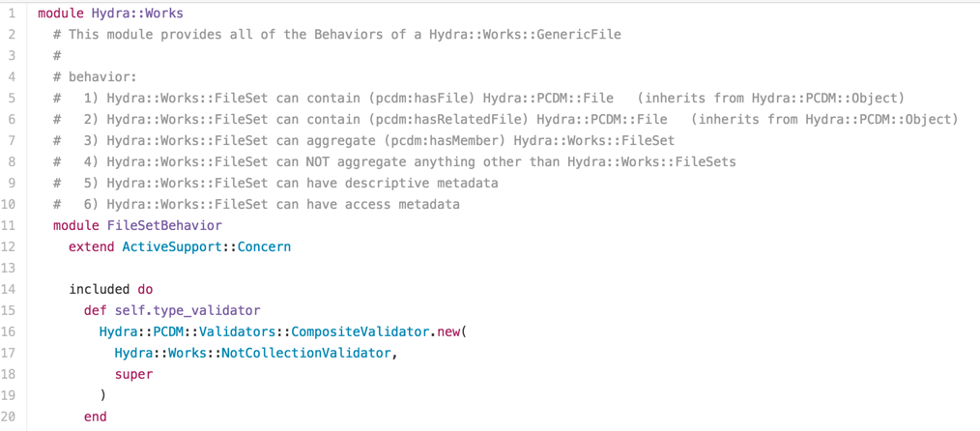
Application Logic & Data Models with RDF
github.com/projecthydra/hydra-works/blob/master/lib/hydra/works/models/concerns/file_set_behavior.rb
Notes:
Here I’ve pulled a snippet from the Hydra::Works Ruby gem. This particular file defines HydraWorks Fileset behavior (Fileset being a particular class of object in HydraWorks). Due to helpful notes but also reading the ruby code, we can start to understand how the Hydra Works Model - which extends PCDM - is being translated and captured in HydraWorks the Ruby Gem / Application logic.

Slide 61
Data Models & Metadata Standards
Rules that Establish Common Semantics for Particular Domain of Data
In turn supports “Correct” Use & Understanding of Data by Users vis-a-vis Commonly-Defined Attributes
Data Models leverage Metadata Standards to define their own Semantics & Requirements
Data Models can reuse, extend multiple Metadata Standards
Standards can be built off of a common Model
Notes:
Finally, what about metadata standards? Data Modeling and Metadata work are often confused or conflated.
We realize that metadata standards are about establishing common semantics for particular domains or realms. It supports “correct” usage and understanding of data through this shared semantics. This supports reuse and interoperability. It makes metadata work easier (in theory), as folks can build off of existing, shared standards.
Data Models leverage metadata standards to define their own semantics requirements. You see Dublin Core, for example, all over the place, because so many data points need a way to express a title.
But more important. Data Models can extend Metadata Standards, while many Metadata Standards are based off of Data Models. They are closely related but not necessarily equivalent - as a Model could use many standards.

Slide 62
Data Models & Serializations in RDF
“Title Value”
“ex12345”
@prefix: <http://example.edu/> .
@prefix dc: <http://purl.org/dc/terms/> .
@prefix foaf: <http://xmlns.com/foaf/> .
:MyCollection a :DigitalCollection ;
dc:identifier “ex12345” ;
dc:title “Title Value” ;
:curator :JaneSmith .
:JaneSmith a foaf:Agent ;
foaf:name “Jane Smith” ;
…
dc:title
dc:identifier
MyCollection
curator
JaneSmith
Notes:
So here we return to our previous example of data serialization, and see how DC is used to both express the Model. By using DC, we’re aligning our model and instance data to a shared set of semantics. This gets more meaningful (and complicated) as you start to work with more constrained metadata standards - like MODS.

Slide 63
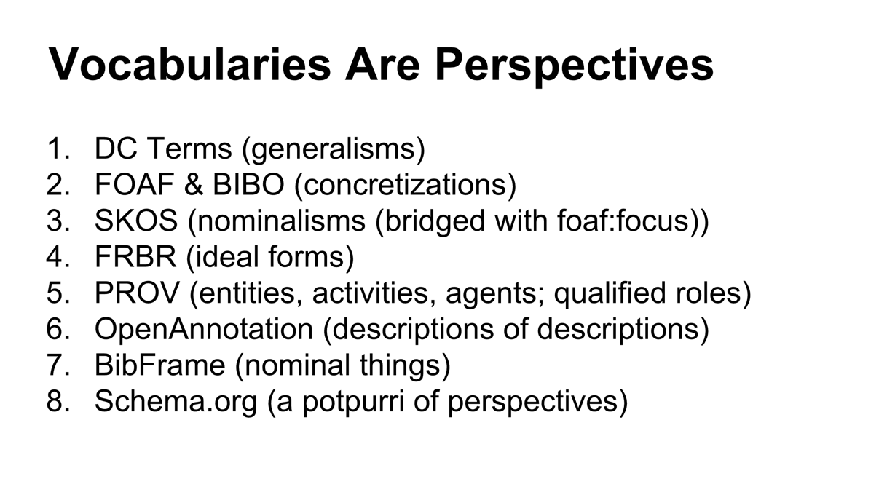
What Are We Describing? Niklas Lindström, ELAG 2015 http://goo.gl/49ZCXW
Notes:
To wrap up this discussion though, I particularly like this slide from a presentation by Niklas Lindstrom who works at the National Library of Sweden. I think it presents us with an interesting view on metadata standards and models, and the domains as well as perspectives they can represent.
(questions, go to break)

Slide 64
Expressing Data Models
Notes:
So before the break, we went through the core ideas of data modeling, as well as how data modeling might show up or interact with our work in a number of related areas.
But, how do we express data models? What does it look like?

Slide 65
Quick Review of Modeling Languages
How models get expressed - a limited review of some conceptual modeling languages & methods:
UML*
XML*
Java (Ruby, Python, ... Programming Language) Classes
RDF
Diagramming
Notes:
This is a short subset of data model expression languages for the sake of having a reference when starting to write these models.

Slide 66
Universe Modeling Language (UML)
Standardized Modeling Language
Complex but General Purpose
Different Diagram Groups
User for Software Engineering
Visualizes designs of Systems from a few approaches:
Use Cases
Static or Class Diagrams
State changes
...
Notes:
UML is probably one many of us have seen but maybe only a few have used.
Go through points on slide...

Slide 67
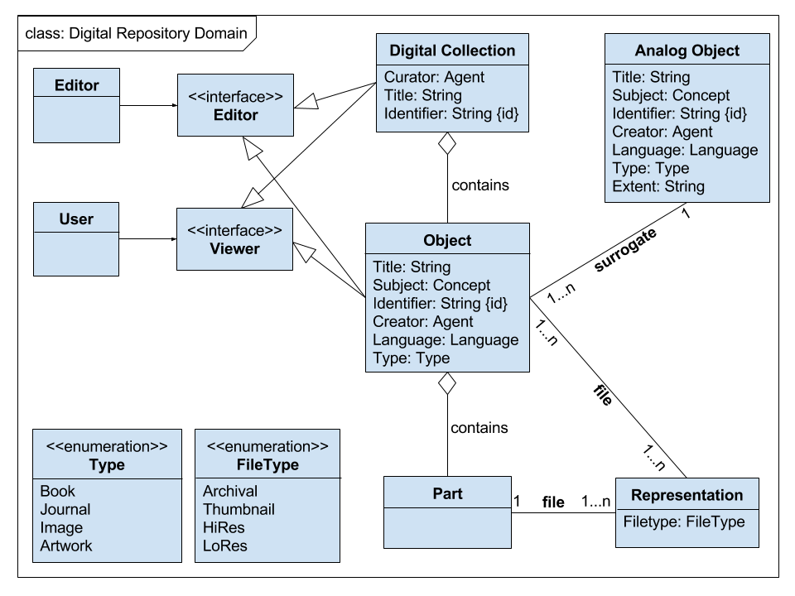
Unified Modeling Language (UML) Simple Class Diagram
uml-diagrams.org/class-diagrams-overview.html
Notes:
Here is a very basic _Class_ or _Static_ UML Diagram, taken from our previous example. You can see how entity classes are captured with attributes, as well as relationship types and constraints, roles are captured as well. (point out in slide)

Slide 68
XML
Document-focused model, with tree structure containing nodes in hierarchies - elements, attributes, values
Languages that support models in XML:
XML Schema
RELAX NG
Schematron
Notes:
XML is a popular document markup or encoding language that i’m sure we’ve all encountered often.
As far as XML goes for a data modeling expression language, you’ll be working with that document-focused model expression, leveraging the tree structure - nodes, hierarchies, elements, attribuets values.

Slide 69
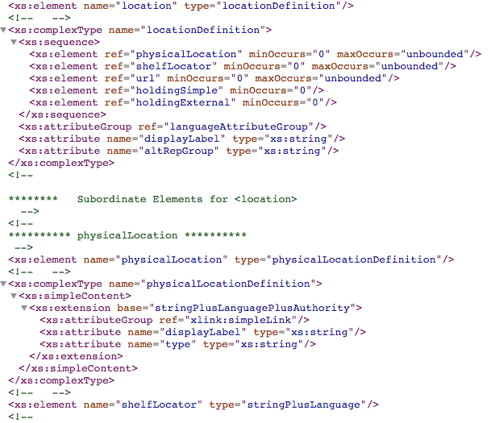
XML data model:
Portion of XML Schema for MODS 3.6
www.loc.gov/standards/mods/v3/mods-3-6.xsd
Notes:
So as an example, here we have MODS/XML - namely, the location portion of MODS model in XML. You can see how the XML document lays out the model structure here - as well as creating options for validation, defining constraints, sequences.

Slide 70
Java Classes
Object-Oriented Programming Language:
Objects aggregate Data, Attributes & Methods
Objects communicate with each other by invoking methods
Basic Programming Unit is a Class
Object == Instance of a Class
In Java, all Classes except Object inherit information defined in another Class
Java’s Object class defines Common Behaviors
Java Classes define Data Representation for Objects
Class declares variables for storing values of Primitive Types & references to Objects
Notes:
Now, data models and object oriented languages have overlap, and the first is expressed in the latter in a few ways. For Java, as well as many other Object Oriented Programming Languages, objects are instances of classes, classes are the basic programming unit, and those classes act very much like our entity types, with the relationships becoming methods or functions.
In Java specifically, there is an Object class defined from which all other expressed Classes inherit information - namely, common behaviors for Objects.

Slide 71
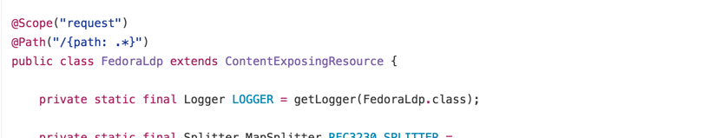
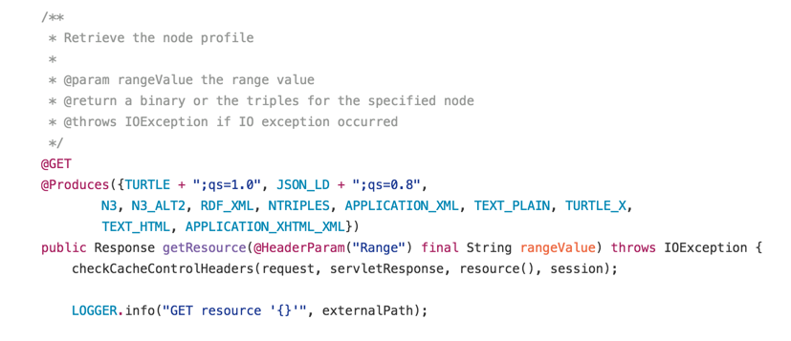
Data Models Captured in Java Classes
[ SKIPPED / PARAPHRASED CONTENT HERE ]
[ … ]
https://github.com/fcrepo4/fcrepo4/
Notes:
Here we see a **PARAPHRASED** java class defined in Fedora 4 - namely, the FedoraLDP class.
You can see what classes this extends, you can see how it defines a certain method - the GET method on this FedoraLDP object. Expected behaviors and outcomes.

Slide 72
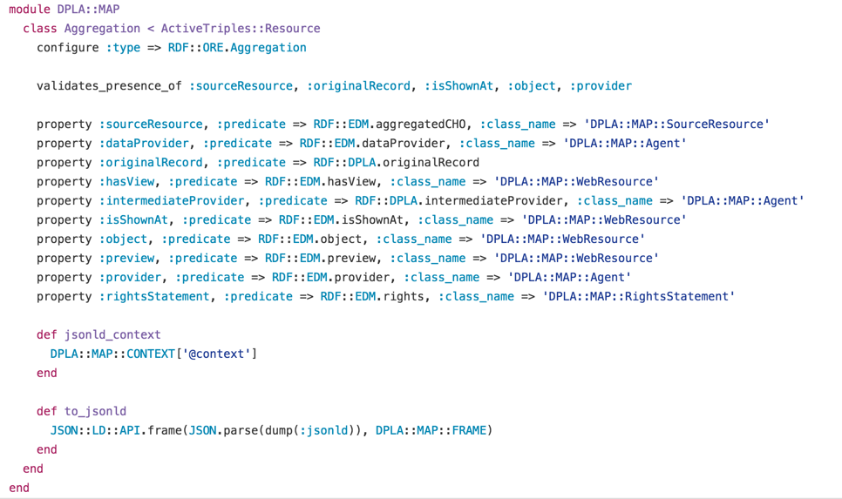
Data Models with Ruby Class Using ActiveTriples
https://github.com/dpla/dpla_map/blob/map-4.0/lib/dpla/map/aggregation.rb
Notes:
As a quick side note, we should also be aware of this relationship between data models - especially RDF, our particular focus here - and ruby - another object-oriented programming language.
The particular snippet/example here is from the DPLA Metadata Application Profile - or, their metadata model - expressed in ActiveTriples, a Ruby library that translates RDF to Ruby Classes and properties. This makes the RDF data models into Ruby objects that applications can then interact with - and not lose the modeling work that feeds into the application.

Slide 73
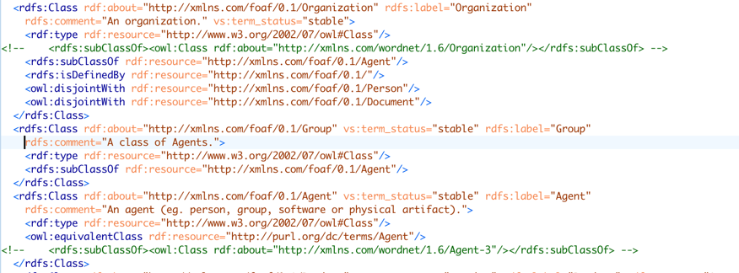
RDF, RDFS, OWL, RDF/XML - here, FOAF
http://xmlns.com/foaf/spec/
Notes:
You can also have RDF expressed via XML serialization, using RDFS and OWL meta-modeling languages.
This particular example is the part of FOAF - or the Friend of a Friend ontology - that defines the concepts of Organization, Group, and Agent. Note the definitions, relationships to other classes/concepts, and the equivalences to external ontologies.

Slide 74
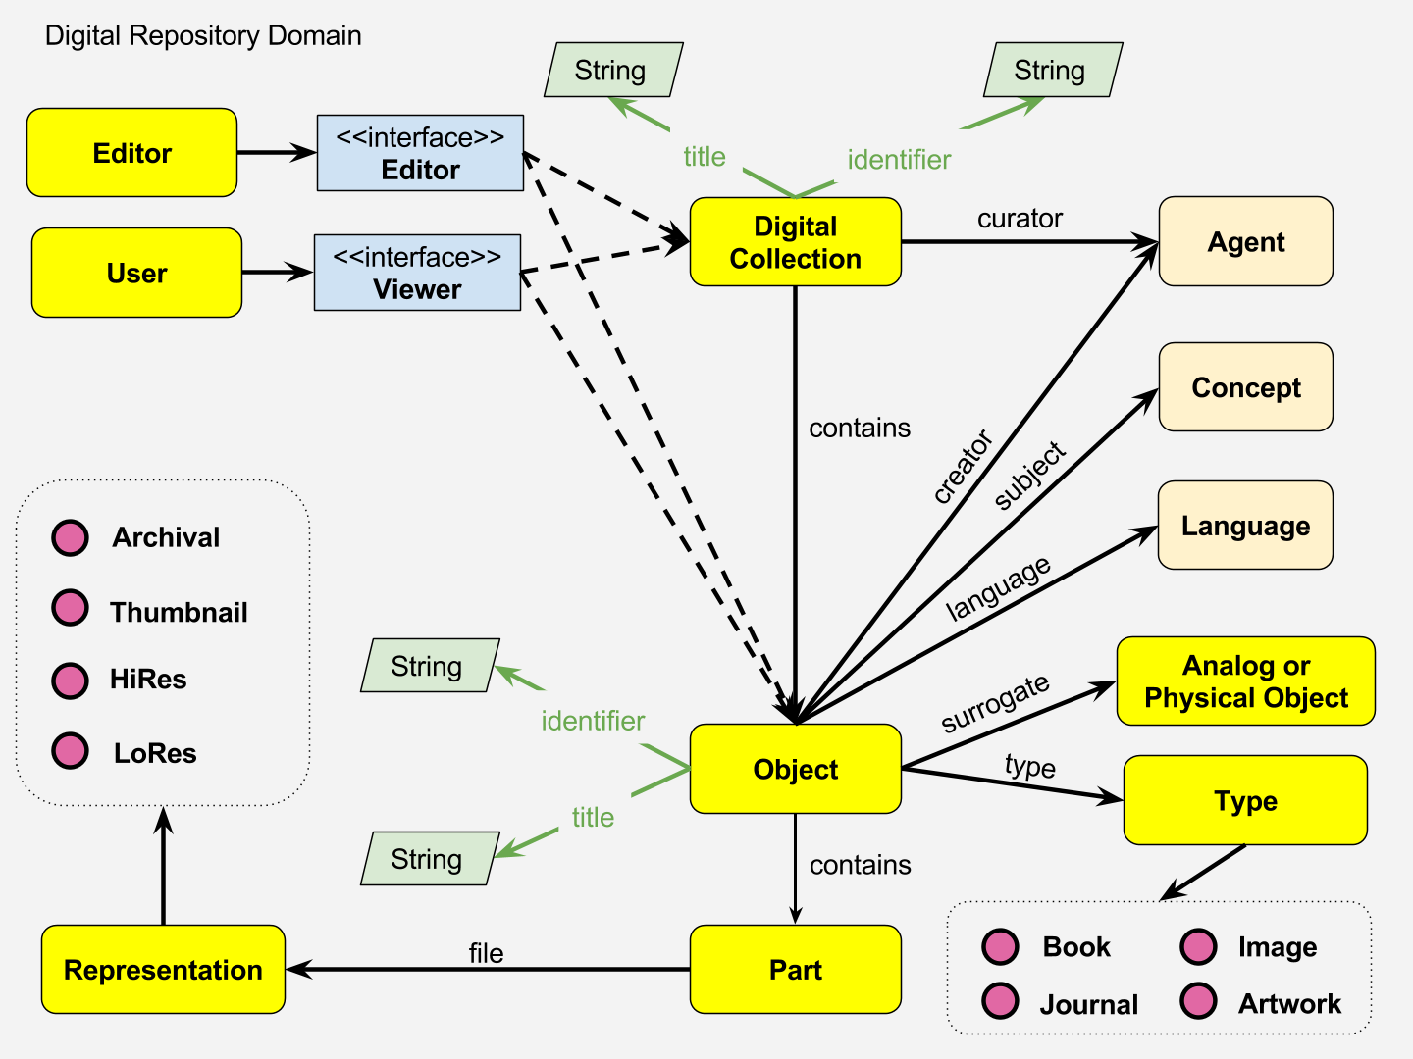
RDF Diagram (Mostly) Using Graffoo
essepuntato.it/graffoo
Notes:
Finally, we have the approach of expressing models via diagramming - where we all start with our whiteboards. See here the example from before, which is mostly RDF-influenced diagramming (it takes interface and functionalities diagramming from UML, kind of). This follows Graffoo, a specification and extension to the diagram editor YeD to define a common diagramming approach to RDF.

Slide 75
Data Models Breakouts

Slide 76
3 Data Models Breakout Groups Options
Portland Common Data Model (PCDM)
Europeana Data Model (EDM) / Digital Public Library of America (DPLA)
International Image Interoperability Framework (IIIF)
Notes:
Explain the breakouts idea. 3 groups, 3 different models.

Slide 77
Portland Common Data Model (PCDM)
Started Officially in 2015
Community Effort for Interoperable Modeling of Digital Repository Objects
PCDM extends Object Reuse & Exchange (ORE) Data Model
Interacts with Other Specifications (like LDP), Platforms (like Fedora 4), but Modeled to be Neutral
Hydra works with PCDM Data from Datastore (Fedora 4) by Translating into Ruby Objects leveraging ActiveFedora
Notes:
What PCDM breakout will focus on

Slide 78
PCDM “Core”
github.com/duraspace/pcdm/wiki
Notes:
See PCDM

Slide 79
Europeana Data Model (EDM) / Digital Public Library of America (DPLA) MAP
RDF-based, Descriptive Models
Focus is Cultural Heritage Resource Aggregation
Extends CIDOC-CRM as well as Other Models, Vocabularies
DPLA is Subset of EDM
Basis for Profiles, i.e. not Designed to be Exhaustive
More Concerned with Resource Description than System Functions
Notes:
What the Europeana + DPLA group will focus on

Slide 80
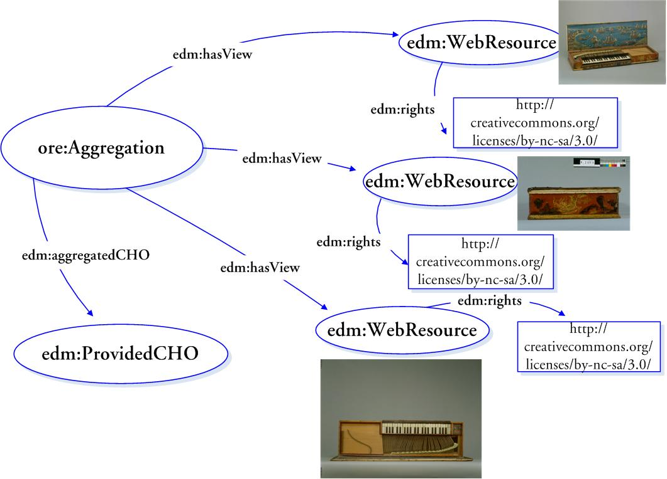
Fragment of Europeana Data Model Diagram
pro.europeana.eu/page/mimo-edm
Notes:
See Europeana (fragment)

Slide 81
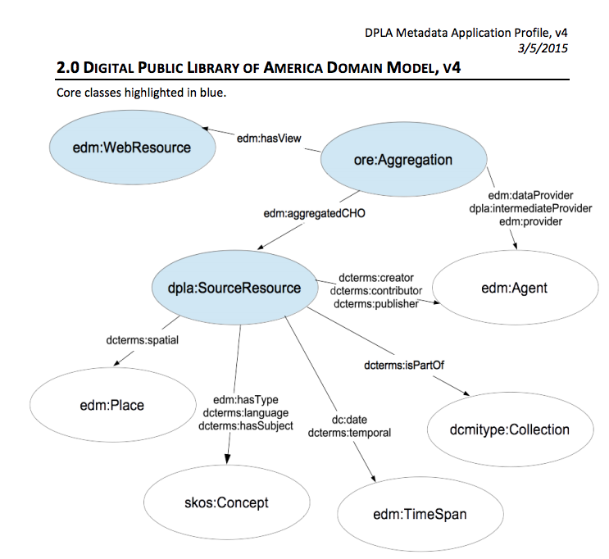
DPLA v.4 Model Diagram
dp.la/info/developers/map/
Notes:
See DPLA Metadata Application Profile v.4

Slide 82
International Image Interoperability Framework (IIIF)
Set of 4 APIs & Models Working Together to Share Images:
Presentation (the focus of the break-out)
Image
Authentication
Search
Growing Range of IIIF-Compatible Image Viewer Systems
Mirador
Universal Viewer
...
Notes:
Finally, what the IIIF group will focus on

Slide 83
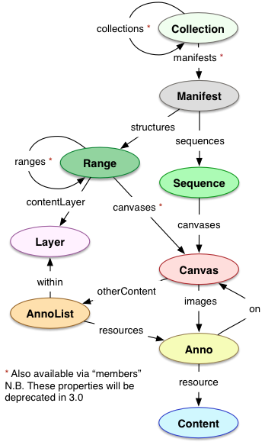
IIIF Presentation API Model
Diagram
iiif.io/api/presentation/2.1/
Notes:
Which is primarily 1 of the 4 APIs, the presentation API

Slide 84
Data Models Breakouts Activity
Learn about Your Data Model & Discuss:
Entity Types ;
Relationships Types ;
Attributes .
Contextualize within Domain, Applications, Standards ;
Diagram an Instance of the Data Model with a Shared Example.
* Please Capture Work & Diagrams in the Shared Notes *
Notes:
In your breakout groups...

Slide 85
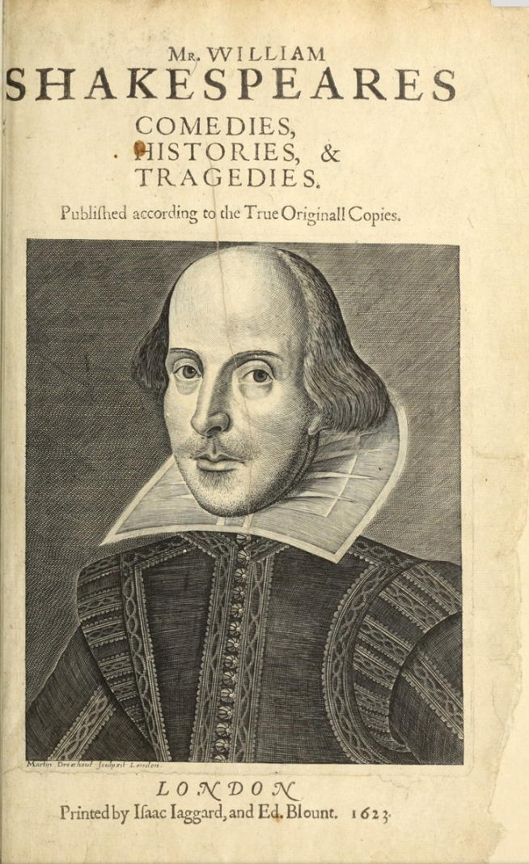
Breakouts’ Shared Example
http://bit.ly/HC16DataModelExample
Digital Surrogate of “This, the first edition of the collected plays of William Shakespeare, is commonly known as the First Folio. Printed in London and issued in 1623...” in the Boston Public Library Digital Collections.
Notes:
And use this singular resource example when working with your models

Slide 86
Breakouts until 11:50
PCDM - Stage
IIIF - Lobby
EDM/DPLA - Back of auditorium
Use the Shared Drive for Notes
Notes:
Assign room areas based off of size (raise of hands)

Slide 87
10 Minute Break
Reconvene at 12:05 ish

Slide 88
Breakouts Recap
Volunteer from each Breakout to Report Back on Your Group’s Modeling Work
Notes:
Get a volunteer from each group to report back.

Slide 89
Different Models, Different Data?
How do our breakout group responses, ideas, approaches compare?
How do we use modeling to build interoperability + shared understanding?
Where do we see differences in what data modeling accomplishes across these breakouts?

Slide 90
Building Data Modeling in the Hydra Community

Slide 91
Maintaining Hydra Data Modeling Momentum
Hydra Metadata Interest Group
#metadata on project-hydra Slack
Project-hydra Slack channels that discuss modeling:
#architecture
#geomodeling
#hylandora
Hydra-Tech Mailing List
Notes & Shared Resources from Workshop- Keep Adding to this!

Slide 92
Broader or Related Communities Working on Modeling
PCDM
IIIF
Fedora 4 (& Fedora broadly)
Islandora
CLAW / Islandora & Fedora 4 Architecture
Islandora Interest Groups (Includes Metadata)
Europeana Data Modeling Work
W3C Efforts: LDP, Shapes, …
DCMI Work

Slide 93
Data Modeling Tools & Resources
Data Modeling Resources Going Forward
Starter List of Tools
Some Links to Modeling Work in Cultural Heritage Institutions
Data Modeling Needs in Hydra & Related (PCDM, Fedora) Communities:
Location for Open Discussions & Issues

Slide 94
Your ideas to continue support for data modeling in communities?

Slide 95
Thank you!
bit.ly/HC16DataModels

